Slide 1
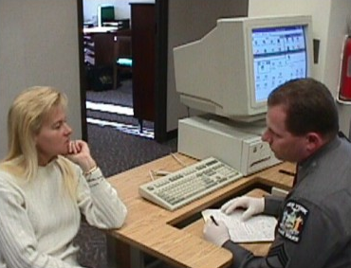



Session 3
Development and Effectiveness of the Drug Evaluation and Classification
Program

Slide 2
Learning Objectives
State origin and evolution of DEC Program
Describe DEC Program research and validation
Discuss DEC Program acceptance in the courts

Slide 3


LAPD Developed DRE

Slide 4
LAPD and NHTSA
Developed and validated SFSTs for alcohol-impaired driving
By early 1980’s NHTSA began to assist LAPD in validating DRE program

Slide 5

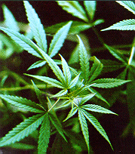
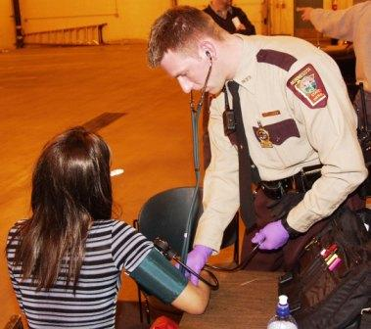
The DRE Process

Slide 6
Reasons for Standardized Procedure
Articulate suspicion of drug influence
Subject may refuse testing
Identify psychoactive impairment
Reduce testing costs
Identify need for medical intervention

Slide 7


Two Stages of Research
Laboratory Evaluation
Johns Hopkins University
Field Evaluation
Los Angeles

Slide 8

Laboratory Evaluation
Johns Hopkins University

Slide 9

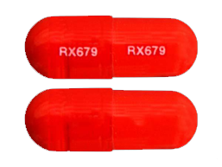
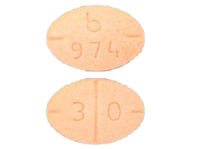

Laboratory Evaluation
Diazepam
Secobarbital
d-amphetamine
Marijuana

Slide 10
Laboratory Evaluation
DRE officers correctly identified 95% of drug-free subjects as "unimpaired"
DRE officers classified 98.7% of high-dose subjects as "impaired"
Correctly identified category of drugs for 91.7% of high-dose subjects

Slide 11
Laboratory Evaluation
DRE officers were less successful in classifying low-dose subjects
17.5% of d-amphetamine impaired
32.5% of weak marijuana impaired

Slide 12
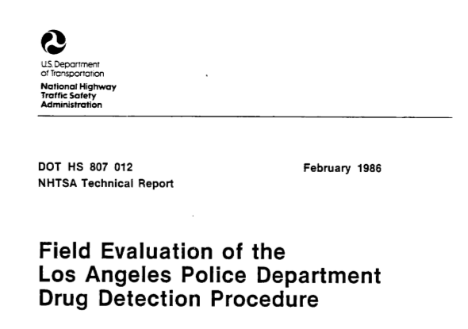
Field Evaluation Los Angeles

Slide 13
Field Evaluation Los Angeles
Blood tests confirmed:
One suspect had no drugs or alcohol
10 had alcohol only
37 (21%) had one drug other than alcohol
82 (47%) had two drugs (including alcohol)
43 (25%) had three or more drugs (including alcohol)

Slide 14
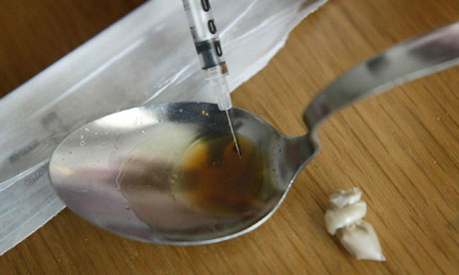
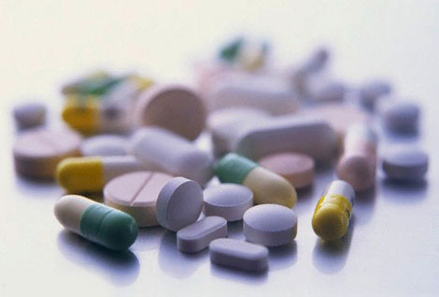
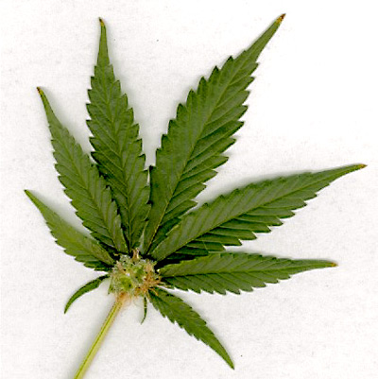
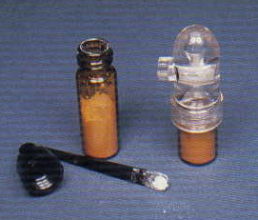
Toxicology Results for Specific Categories
92%: Phencyclidine (PCP)
85%: Narcotic Analgesics
78%: Cannabis
50%: CNS Depressants
33%: CNS Stimulants

Slide 15
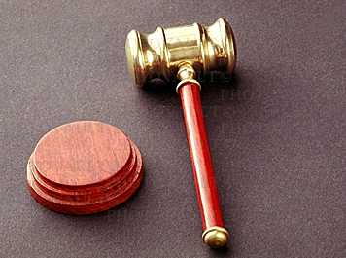
DEC Program Acceptance
“Frye” Standard
“Is the procedure or
principle espoused,
accepted by the
relevant scientific
community?”

Slide 16
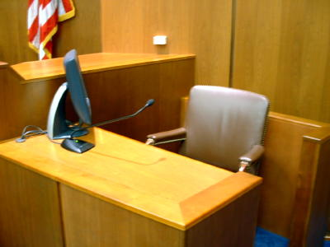
DEC Program Acceptance
“Daubert” Standard
Shows reliability before scientific evidence can be admitted

Slide 17
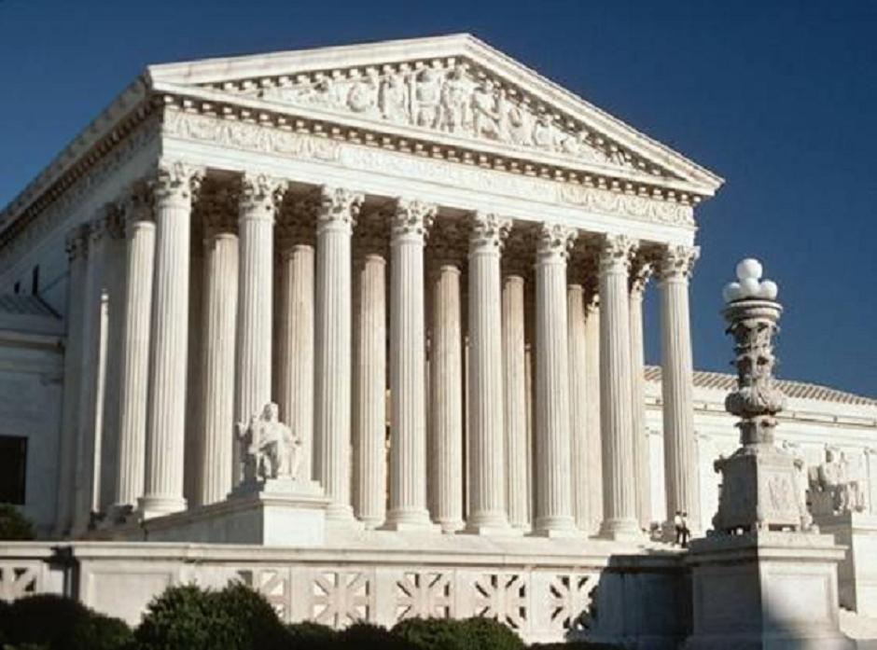
DEC Program Acceptance
“Frye” Standard
Arizona v Johnson
Colorado v Hernandez
Minnesota v Klawitter
Washington v Baity

Slide 18

DEC Program Acceptance
“Daubert” Standard
New Mexico v Aleman
Nebraska v Daly

Slide 19

Horizontal Gaze Nystagmus Case Law
Arizona v Blake

Slide 20
Questions?

Slide 21
Test Your Knowledge
State four reasons why it is important not to rely simply on a chemical test to establish a subject’s impairment.
What categories of drugs were included in the Johns Hopkins Evaluation?
In what percentage of cases in the Los Angeles Field Evaluation did blood tests support the DREs’ opinion PCP was present?

Slide 22
Test Your Knowledge
What percentage of blood tests in the LAPD Field Evaluation supported the presence of at least one drug category identified by the DREs?
What was the landmark State Supreme Court case that upheld the use of HGN as evidence of impairment?
Which landmark expert testimony court decision requires the court to have a “gate-keeper” role and screen evidence?

